Slide 1
GROUP 1 – MOCK PROJECT- FAST TRACK HN23_FR_EMB_05.1
MEMBERS:
Hoang Van Hieu (HieuHV18)
Nguyen Van Duc (DucNV74)
Nguyen Minh Bac (BacNM)
Nguyen Duc Trung (Trungnd69)

Slide 2
Architectural view model
Requirements analysis
Logical View
Process View
Development View
Physical View
Scenarios

Slide 3
Requirement analysis
Provisioner
Gateway
Light
Devices
Swtich
Sensor
Mobile App

Slide 4
Provisioner Requirements
Req_ID | Description
Req_01_001 | Able to assign devices into 2 different groups
Req_01_002 | Using LED to indicate the status of the provisioning process

Slide 5
Gateway Requirements
Req_ID | Description
Req_02__001 | Transmit and receive data over UART
Req_02__002 | Enable command passing over UART connection to change the state of light elements according to their unicast address
Req_02__003 | Acting as an intermediary device to receive events from the switch and motion sensor and then print the message on the computer screen through the UART connection

Slide 6
Light Requirements
Req_ID | Description
Req_03_001 | Use generic state on/off to control lights
Req_03_002 | Support CTL (Color Turn-able Light) light element and another light element
Req_03_003 | Send a heart bit signal to the gateway in range

Slide 7
Switch Requirements
Req_ID | Description
Req_04_001 | Change the state of all light elements in the group
Req_04_002 | Always active at EM2

Slide 8
Sensor requirements
Req_ID | Description
Req_05_001 | When motion is detected (using a button), send a light-on request to every light element in the group, the light stays on for a period pre-set by the user.
Req_05_002 | Always active at EM2

Slide 9
Mobile Requirements
Req_ID | Description
Req_06_001 | User can control each light element via unicast address via PB-GATT. communication
Req_06_002 | User can perform Secure OTA for all 5 types of devices mentioned above: provisioner, light, motion, switch, gateway.

Slide 10
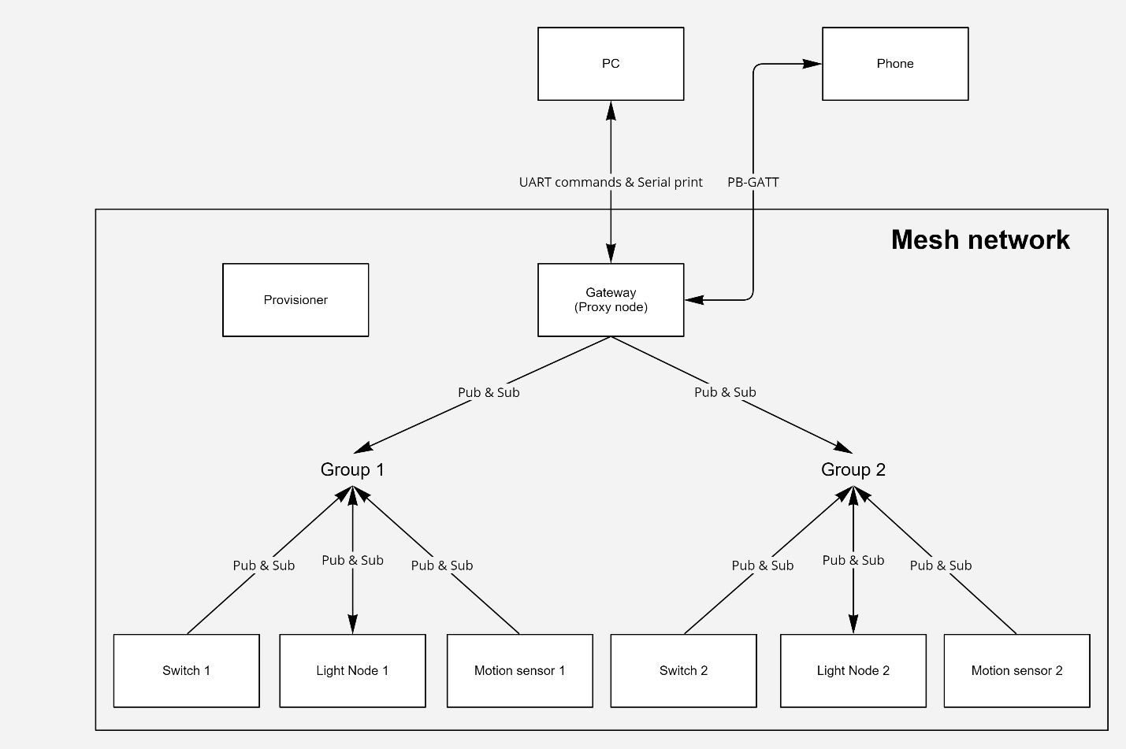
System Architechture

Slide 11
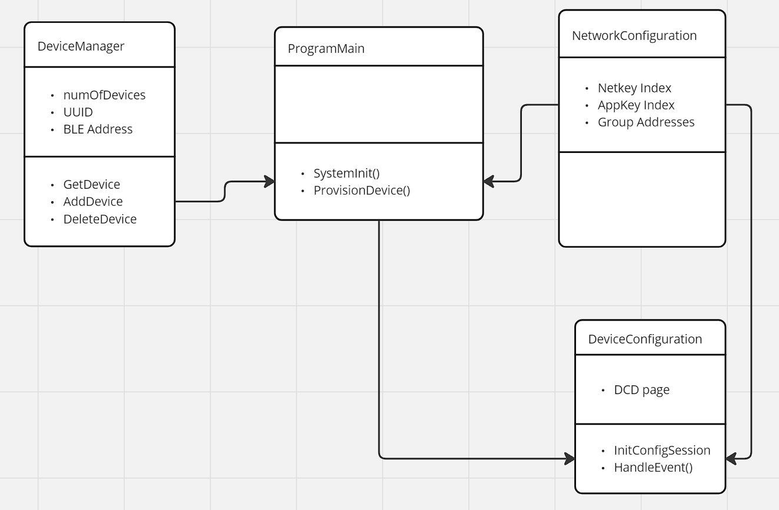
Provisioner - Structure

Slide 12
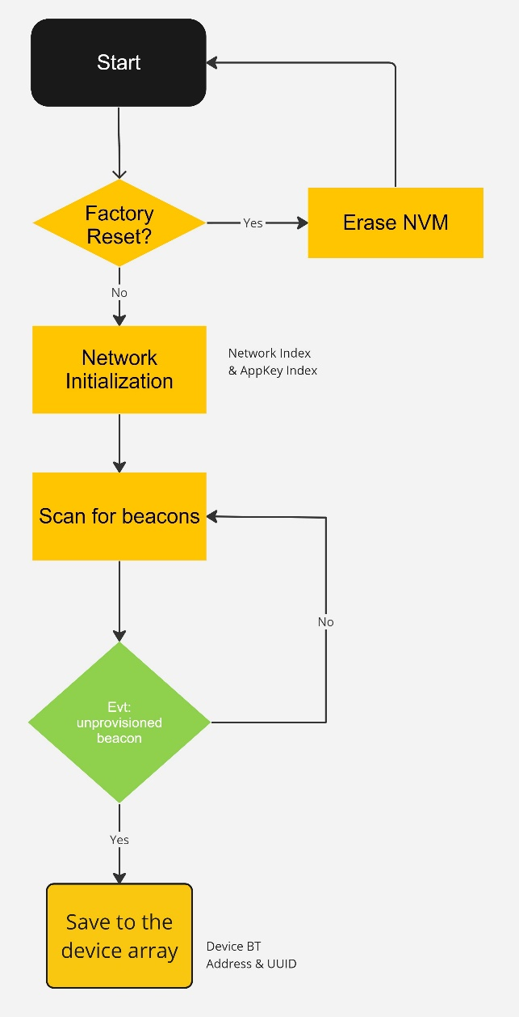
Provisioner – Initialization flow

Slide 13
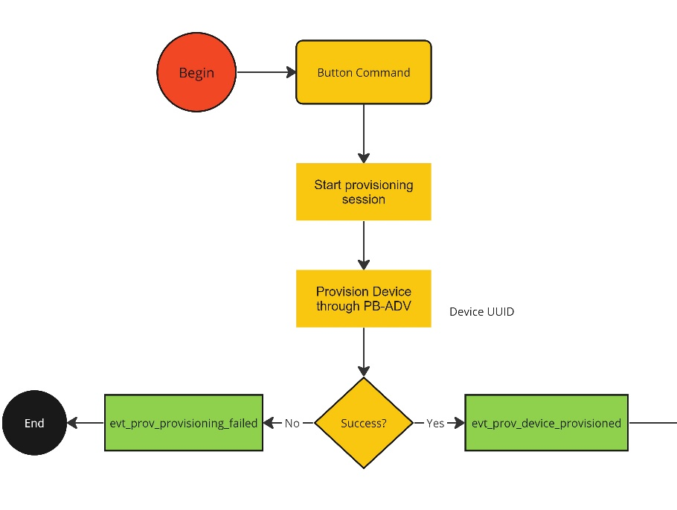
Provisioner – Provision Flow

Slide 14
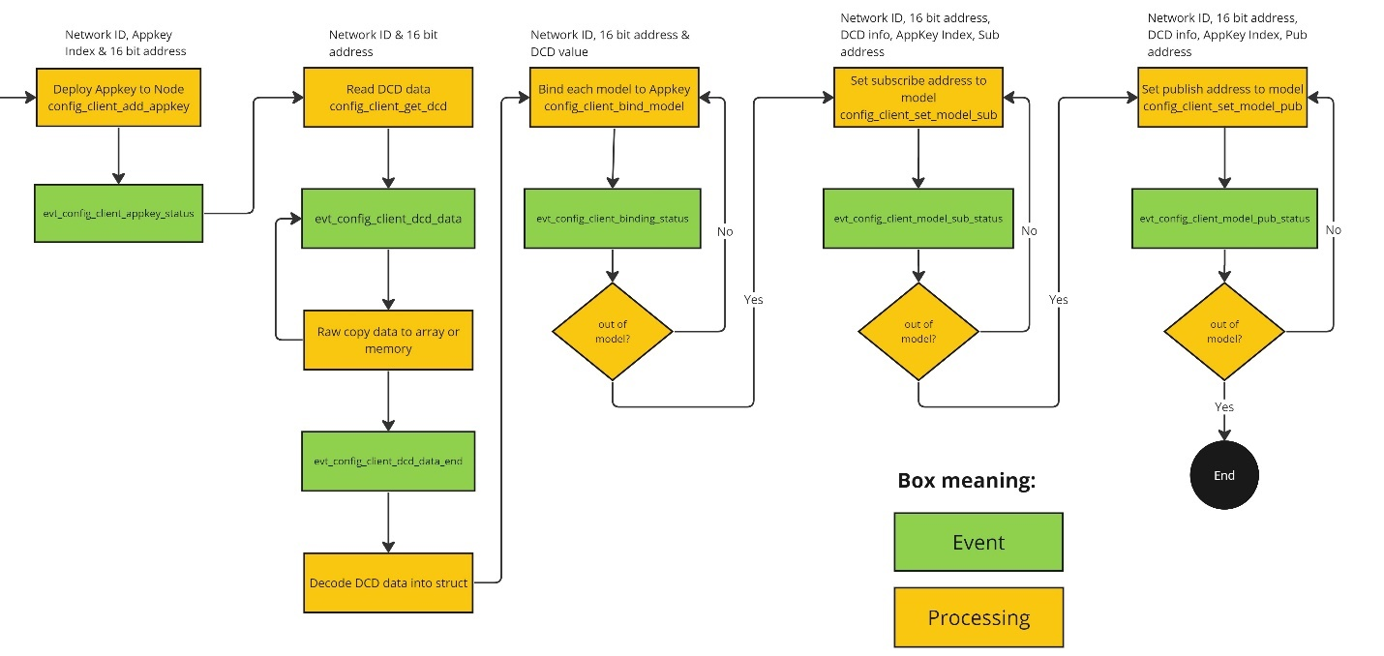
Provisioner – Node configuration flow

Slide 15
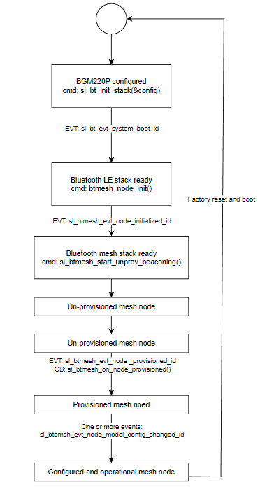
LOGICAL VIEW – PROVISIONING

Slide 16
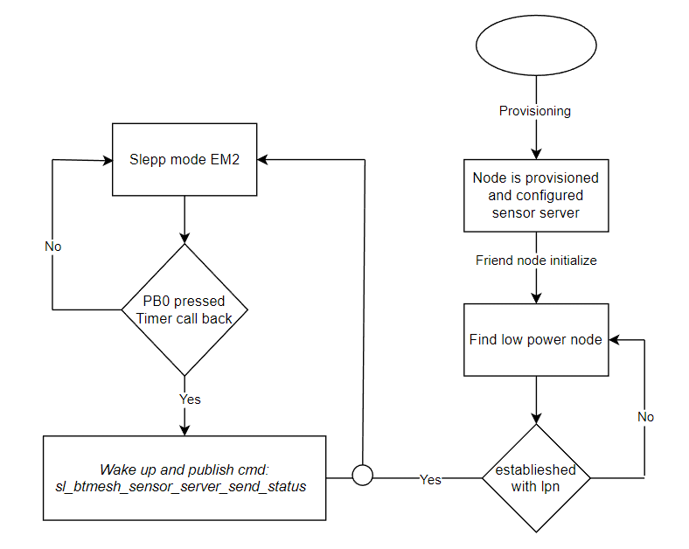
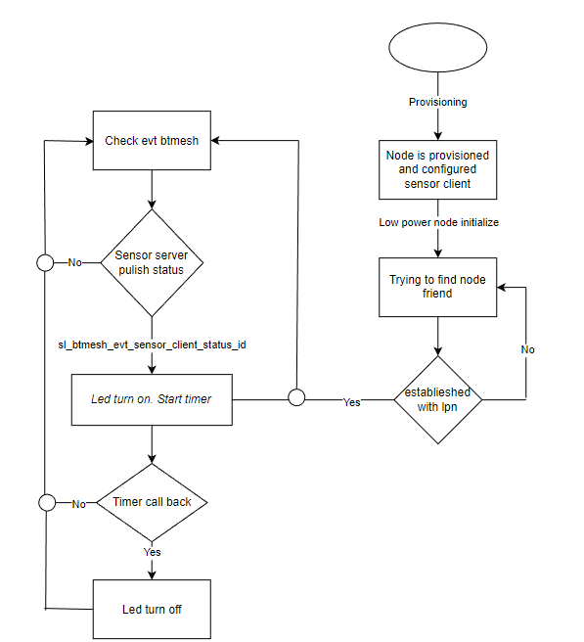
LOGICAL VIEW – SENSOR NODE
Sensor Server
Sensor Client

Slide 17
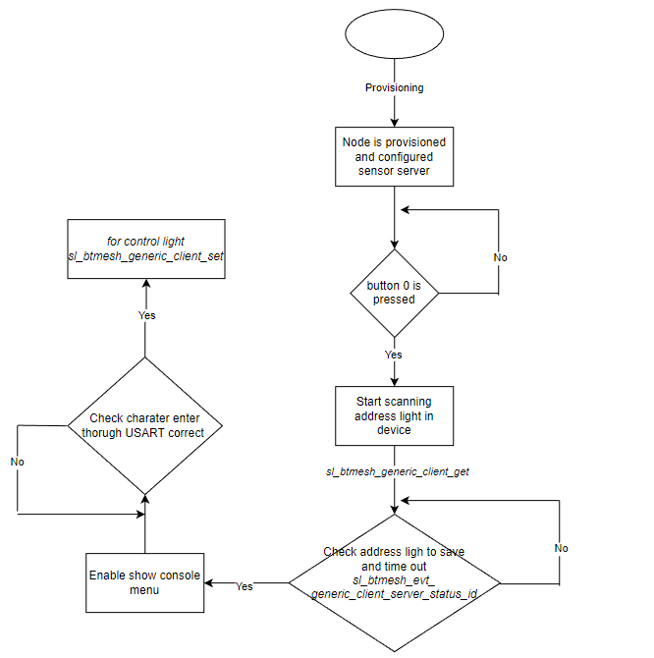
LOGICAL VIEW – GATEWAY

Slide 18
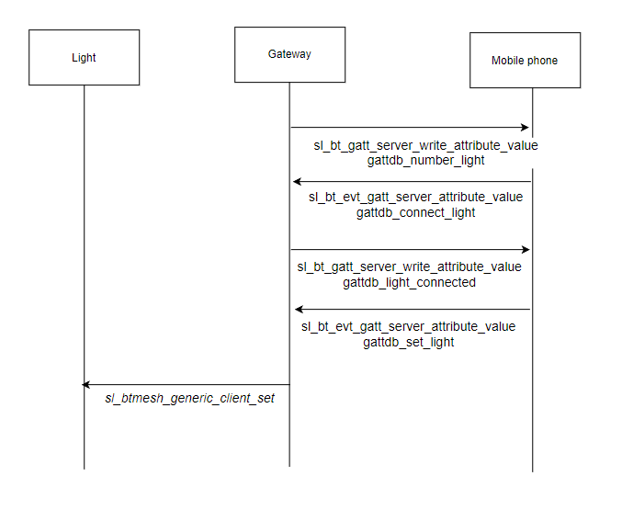
LOGICAL VIEW – MOBILE APP

Slide 19
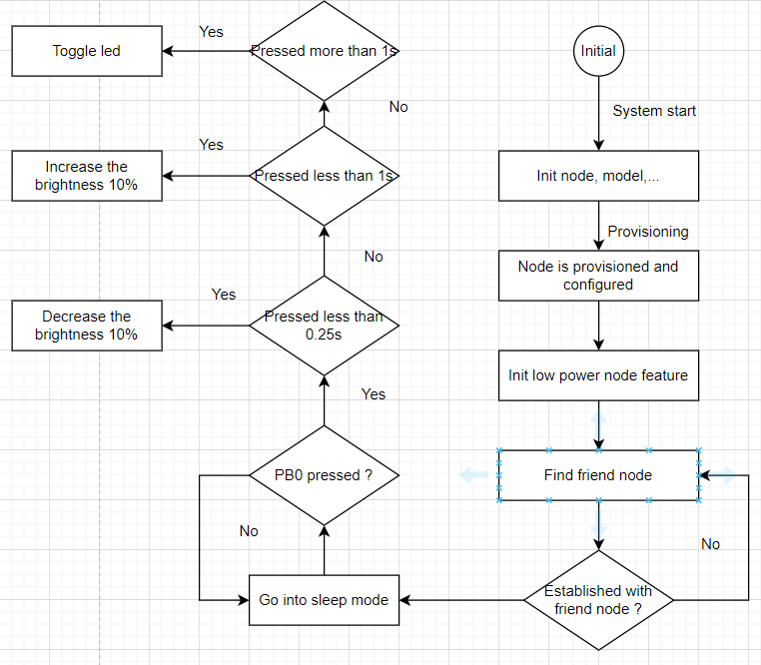
LOGICAL VIEW – SWITCH NODE
Switch Node

Slide 20
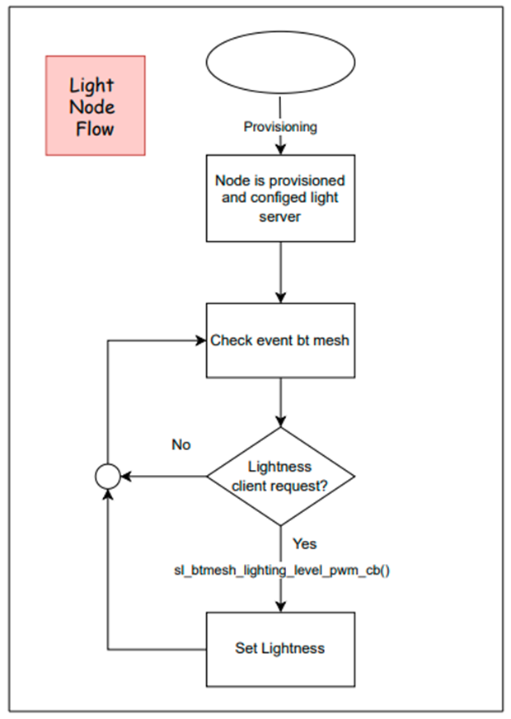
LOGICAL VIEW – LIGHT NODE
LIGHT NODE

Slide 21
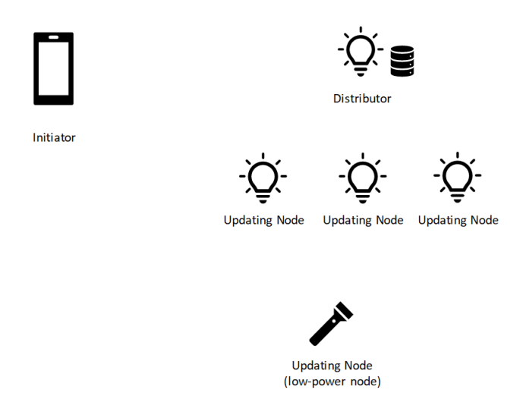
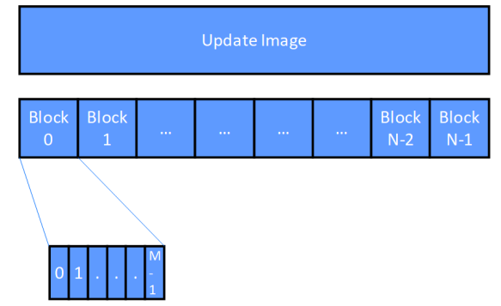
DEVICE FIRMWARE UPDATE
Mesh DFU and BLOB
Notes:
The transfer may be performed in two modes: Push BLOB Transfer mode and Pull BLOB Transfer mode. The MBT client selects the
transfer mode based on the capabilities supported by the servers. The MBT server may support both or only one of these modes.
In the Push BLOB Transfer mode, the client controls the flow of chunks to the servers, sending all the chunks from a block, then queries
the servers to determine which chunks were received. All missing chunks are retransmitted.
In the Pull BLOB Transfer mode, the client transfers a BLOB typically to a single server at a time, although multiple simultaneous receivers
can be supported as well. The server requests chunks from the client as it can process them, and the flow of chunks is controlled by the
server.
A Low Power Node (LPN) typically only supports the Pull BLOB Transfer mode and therefore the Pull BLOB Transfer mode is typically
used only if some of the MBT servers are Low Power Nodes. This mode makes it possible for the MBT server to throttle the transfer
speed. This is necessary to ensure that no more chunks than the Friend node can store in its Friend Queue are transmitted at once.
The MBT client or server model is normally used as a transport in a higher-layer model such as the Firmware Update models
• Initiator role – checks for available updates for the firmware running on Updating nodes that are included in a list provided by a higher-layer application and then sends the new firmware images to a Distributor. The procedures performed by an Initiator are controlled by a higher-layer application. An Initiator might be a smartphone or gateway device that periodically checks product websites for the availability of new firmware images.
Distributor role – delivers new firmware images to the Updating nodes and monitors the progress of the firmware update. The Distributor acts as an intermediary on behalf of the Initiator so that the Initiator does not always need to be present on the mesh network. The Distributor reports progress back to the Initiator when requested. The Distributor continues to have the configured functionality when distributing updates.
Stand-alone Updater role – checks for available updates for the firmware running on Updating nodes and delivers the new firmware images directly to the Updating nodes. A Stand-alone Updater might be a smartphone or mesh gateway device that has access to the Internet while present on the mesh network to check for the availability of new firmware images for the Updating nodes. When a new firmware image is available, it manages the delivery of the firmware image to the Updating nodes without an intermediary Distributor.
Updating Node role – receives firmware updates and updates itself.
The Updating Node stays in normal operation until a reboot with the new firmware

Slide 22
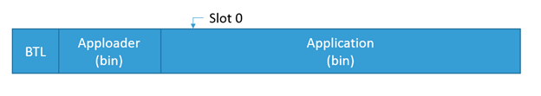
DEVICE FIRMWARE UPDATE
OTA DFU (Over The Air Device Firmware Update)
Apploader
Is a small standalone application that is required to support in-place OTA updates.
AppLoader can run independently of the user application.
Enables OTA updating of user application.
The AppLoader itself can also be updated.
Support encryption and other security features.

Slide 23
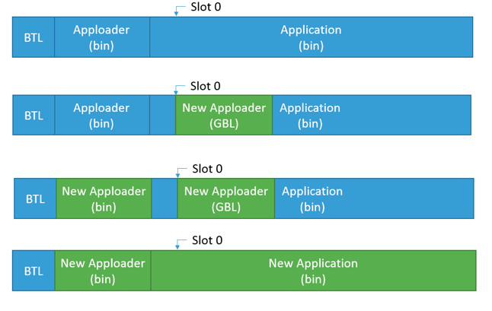
DEVICE FIRMWARE UPDATE
OTA DFU (Over The Air Device Firmware Update)
Full update

Slide 24
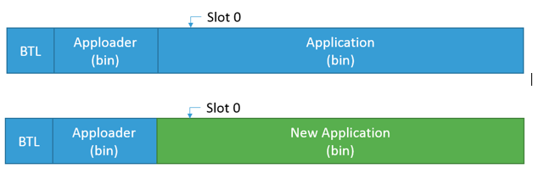
DEVICE FIRMWARE UPDATE
OTA DFU (Over The Air Device Firmware Update)
Partial Update

Slide 25
DEVICE FIRMWARE UPDATE
Secure OTA DFU (Over The Air Device Firmware Update)
STEP:
Create bootloader-apploader project and enable secure boot feature
Create basic application
Create secure key
Signed basic application
Combine bootloader-apploader and basic application to flash to device
Flash key to device
Create upgrade application
Signed and encrypted upgrade application
Update firmware to device

Slide 26

Thank you

